Slide 1
SAP ABAP Architecture

Slide 2
Different architectures
SAP R1 ( 1 tier architecture)
SAP R2 ( 2 tier architecture)
SAP R3 ( 3 tier architecture)

Slide 3
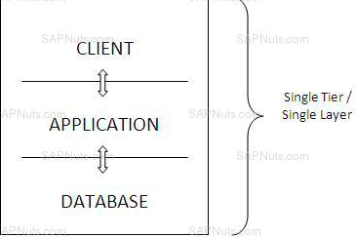
SAP R1
Architecture
Sap R1 is one tier architecture.
R stands for “Real time data processing”.
In R1 architecture all the three components Presentation , Application and Database are merged and installed in a single server .
Disadvantages :
Less security
Only for few users

Slide 4
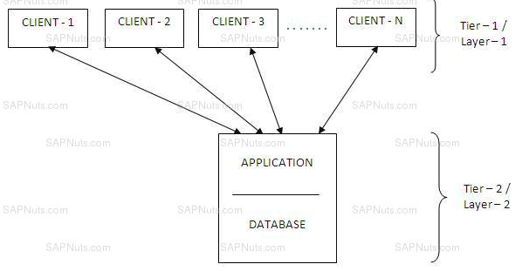
SAP R2
Architecture
Sap R2 is 2 tier architecture.
All three components are installed on two servers.
Presentation component is installed in one system/server
Database and application are installed on other server
Disadvantages :
More complex
2 -100 users
Response time gets increased when no of clients or users increases.

Slide 5
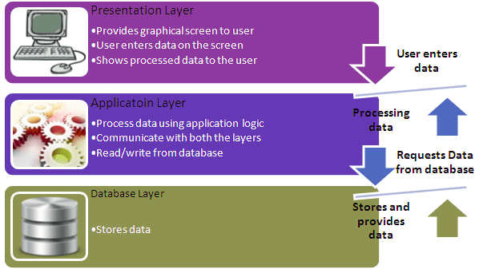
SAP R3
Architecture
Sap R3 is 3 tier architecture.

Slide 6
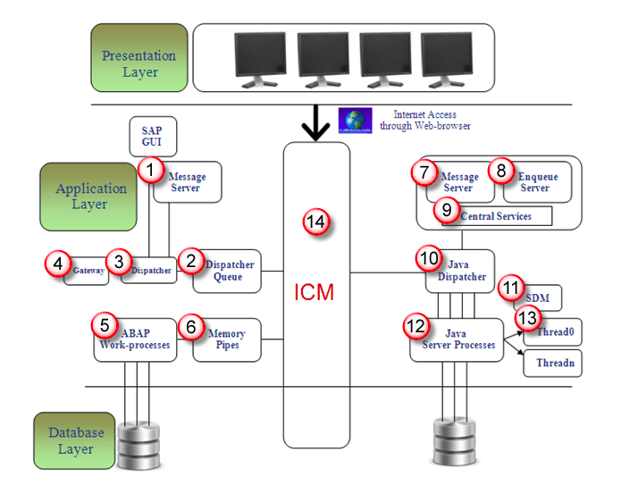
Components of SAP R/3 3-tier Architecture

Slide 7
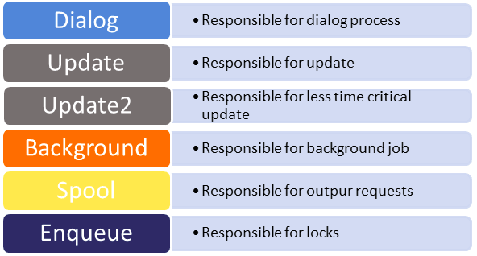
Components of SAP R/3 3-tier Architecture
Message Server:It handles communication between distributed Dispatchers in ABAP system.
Dispatcher Queue: Various work process types are stored in this queue.
Dispatcher: It distributes requests to the work processes.
Gateway: It enables communication between SAP system and between SAP system and external systems.
ABAP-Work processes: - It separately executes dialog steps in R/3 applications.
Types of work processes are given as :-

Slide 8
Components of SAP R/3 3-tier Architecture
Memory-pipes: It enables communication between ICM and ABAP work processes.
Message Server: It handles java dispatchers and server processes.It enables communication within java runtime environment.
Enqueue Server:It handles logical locks that are set by the executed Java application program in a server process.
Central Services: Java cluster requires a special instance of the central services for managing locks and transmitting messages and data. Java cluster is a set of processes that work together to build the reliable system. Instance is group of resources such as memory, work processes and so on.

Slide 9
Components of SAP R/3 3-tier Architecture
Java Dispatcher: It receives the client requests and forwards to the server process.
SDM: Software Deployment Manager is used to install J2EE components.
Java Server Processes: It can processes a large number of requests simultaneously.
Threading: Multiple Processes executes separately in the background, this concept is called threading.
ICM: It enables communication between SAP system and HTTP, HTTPS, SMTP protocol. It means by entering system URL in the browser you can access SAP from browser also.

